Slide 1
Auto Price Pro: Predicting Car Prices with Machine Learning
Course: 2024W-T2 BDM 2053 - Big Data Algorithms and Statistic 02
Submitted to :- Darcy Gratton

Slide 2

Overview
Our focus is on developing predictive car pricing solutions using advanced algorithms like XGBoost. We aim to provide accurate price estimates based on various features, empowering users in the automotive marketplace. Our project combines technology with industry insights to revolutionize the car buying and selling process.

Slide 3
Our goals
Short term
Long term
Utilizing XGBoost, successfully develop the predictive car price model and present it in an intuitive user interface.
Continue to improve the model's accuracy and broaden its coverage of automobile features so that it can eventually be relied upon by buyers and sellers of vehicles.

Slide 4
Table of contents
01
02
03
04
05
06
Data Preprocessing
Data Insights
Choosing the right ML Model
Model Building and Analysis
Visualizations and
Predictions
Conclusion

Slide 5
Data Preprocessing
01

Slide 6
Data Gathering and Exploration
The data for this car price prediction project was collected from Kaggle. The primary source was a dataset obtained from a reputable online marketplace for used cars.
The dataset included various attributes such as make, model, year, odometer reading, MMR (Market Mirror Ratio), interior color, exterior color, transmission, trim, and body type.

Slide 7
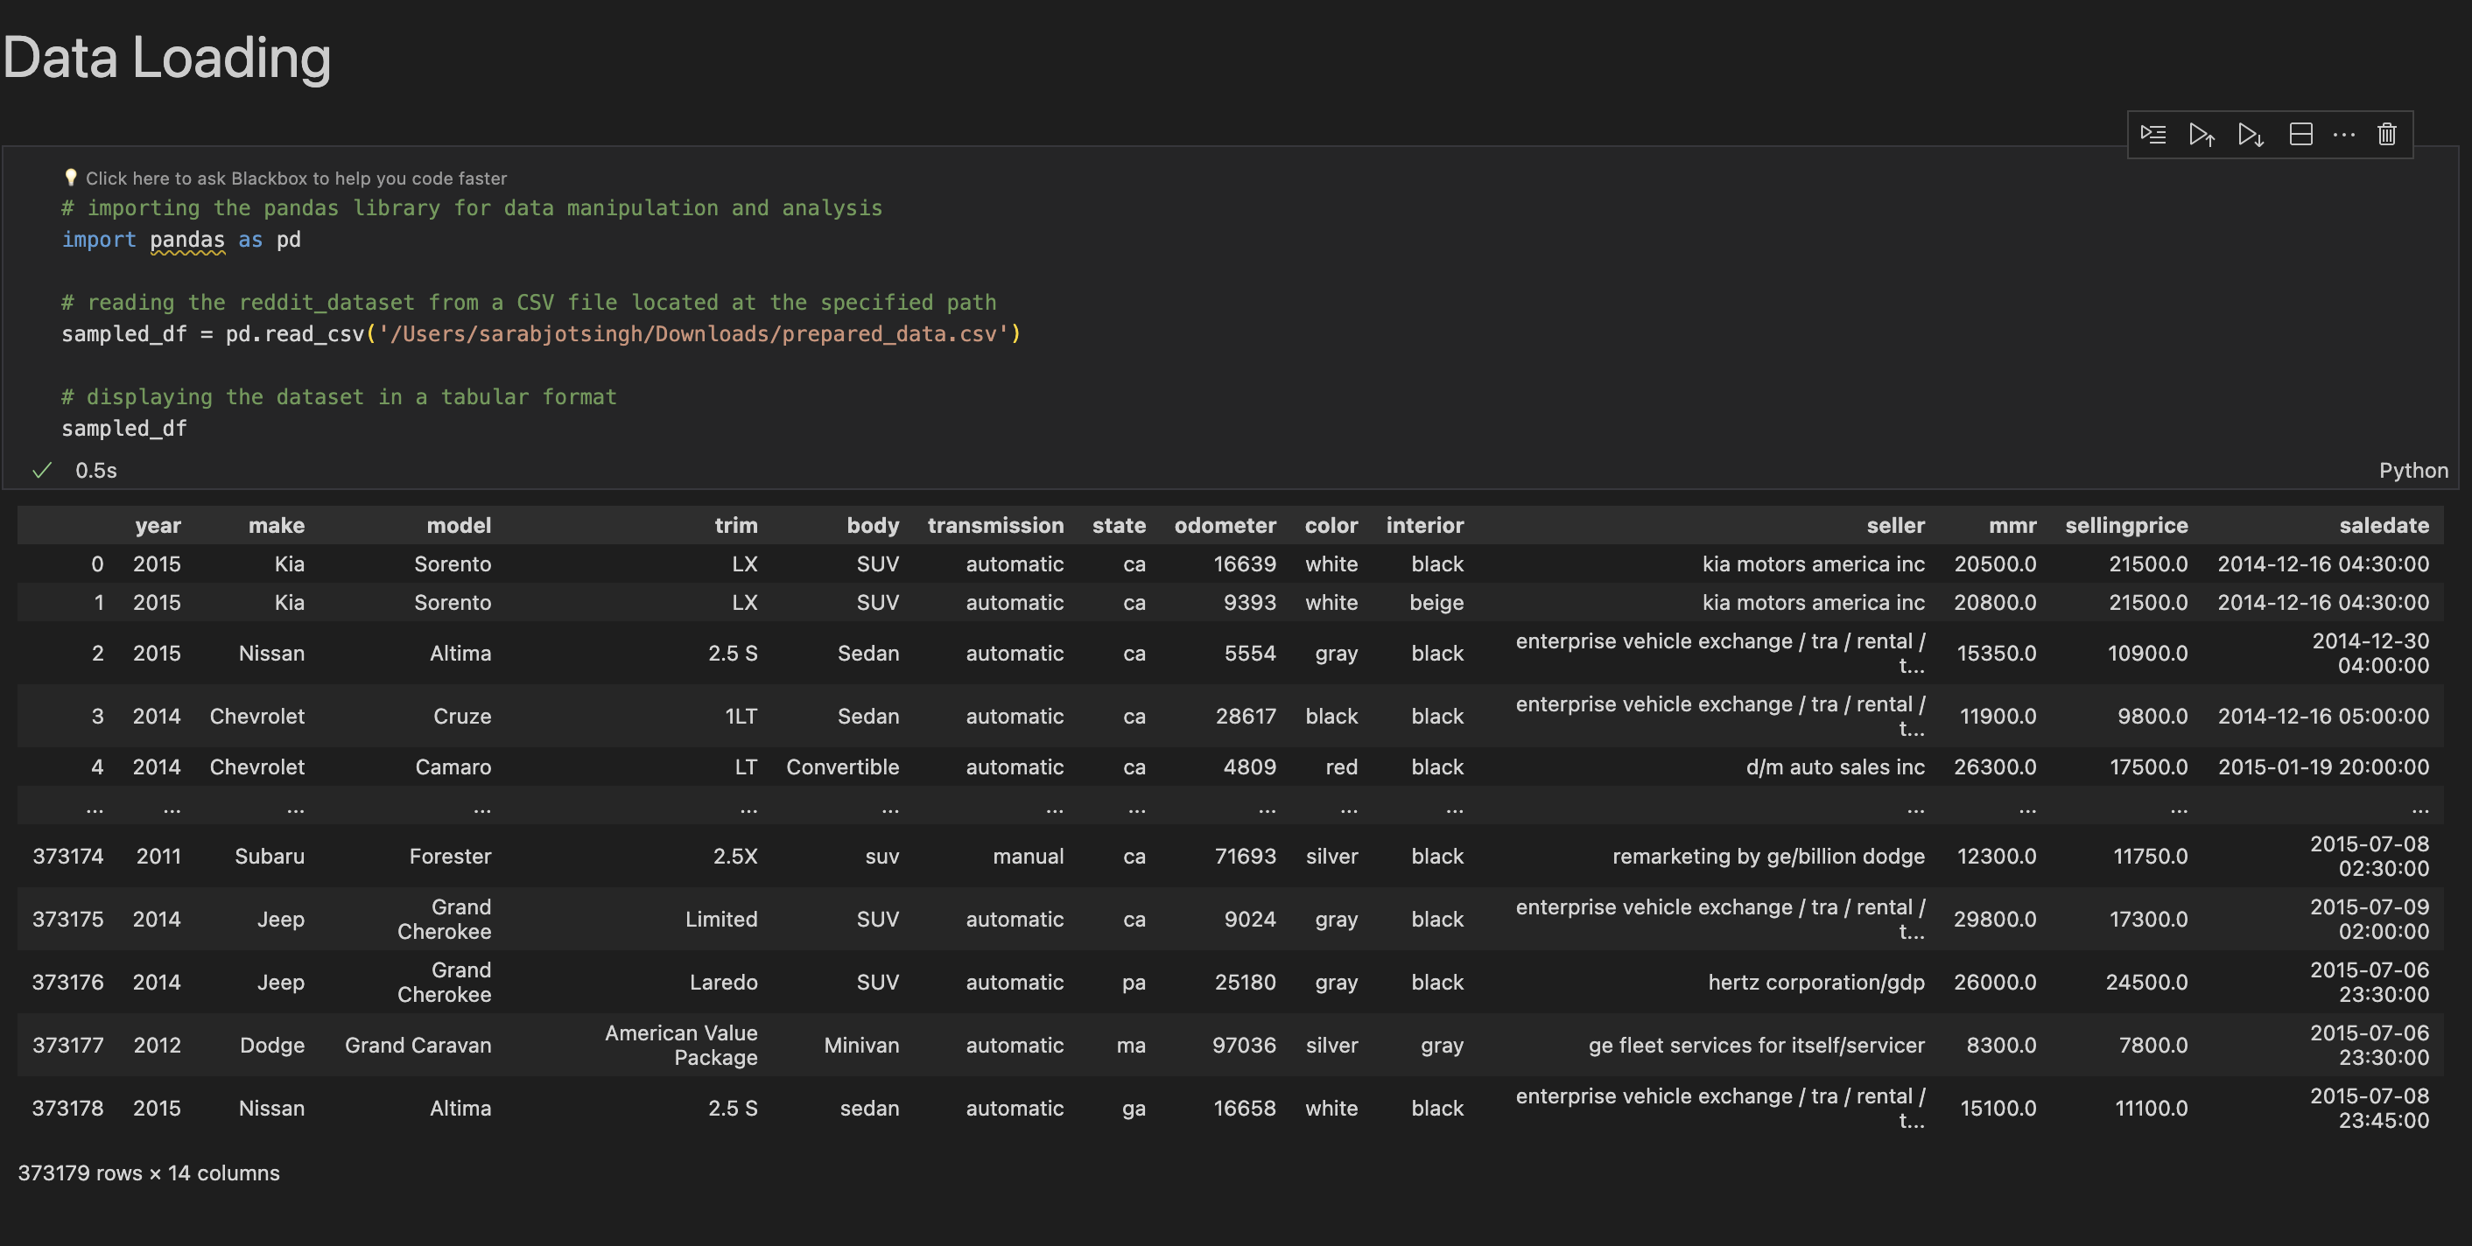
Data Gathering and Exploration

Slide 8
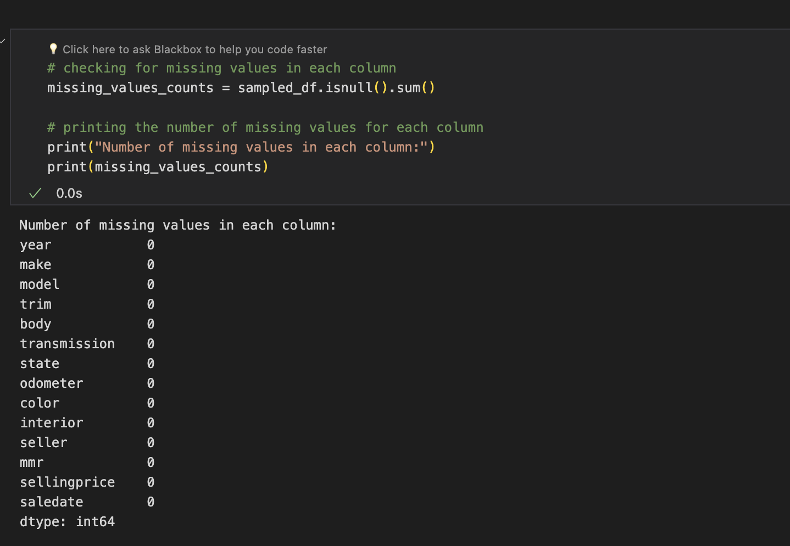
Data Gathering and Exploration

Slide 9
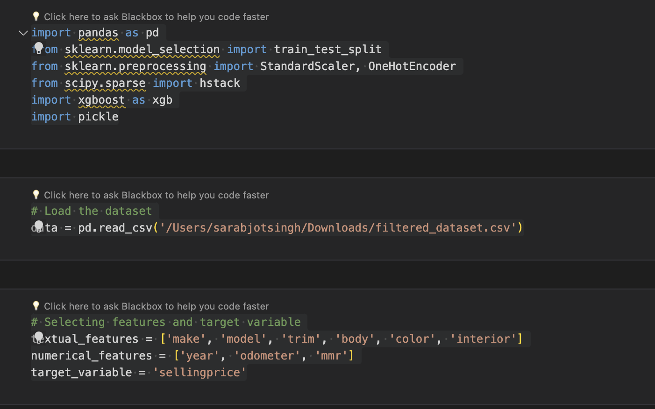
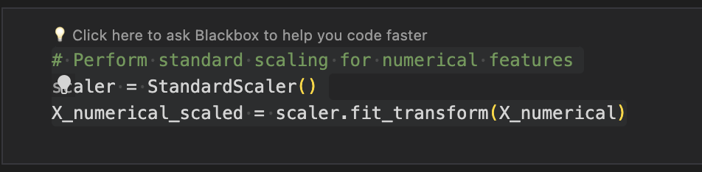
Standard Scaling

Slide 10
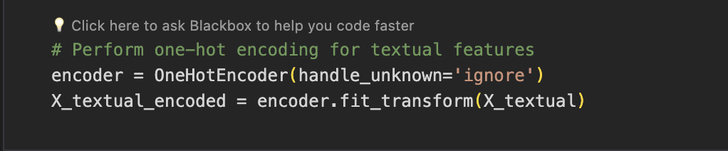
One hot Encoding

Slide 11
Data Insights
02

Slide 12
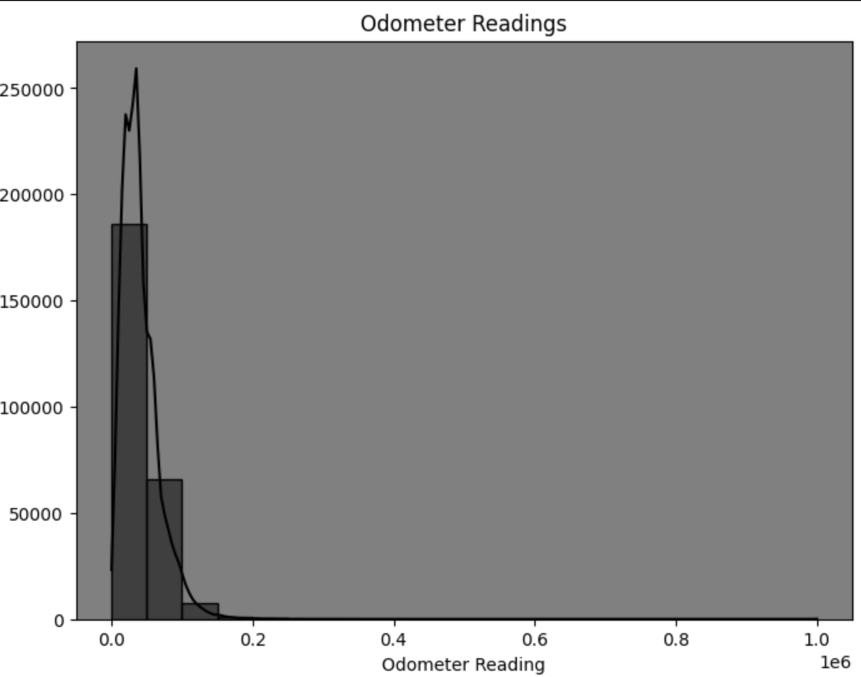
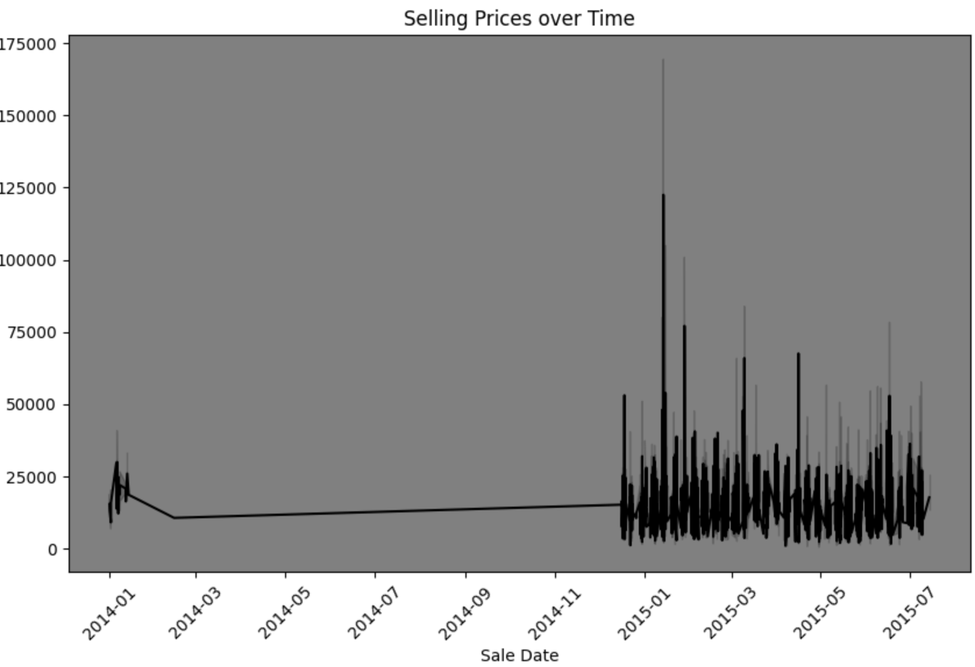
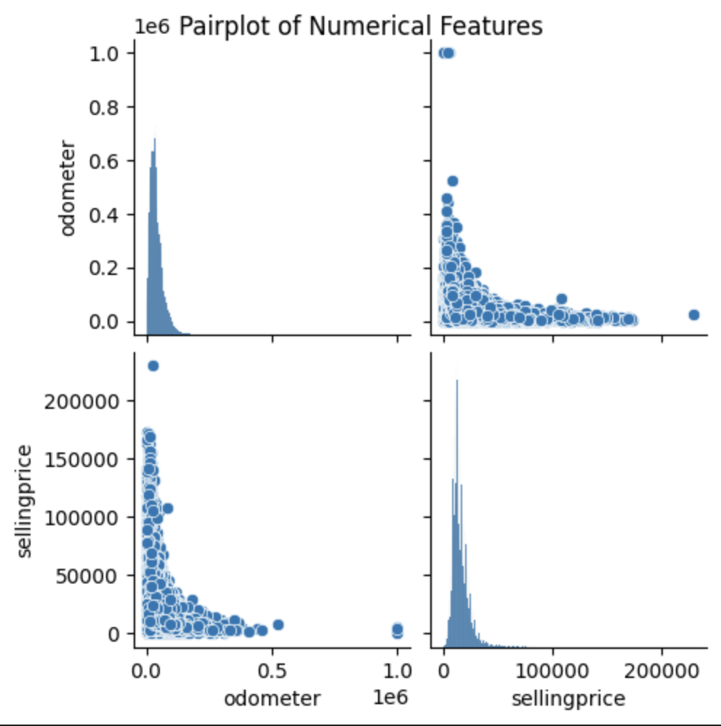
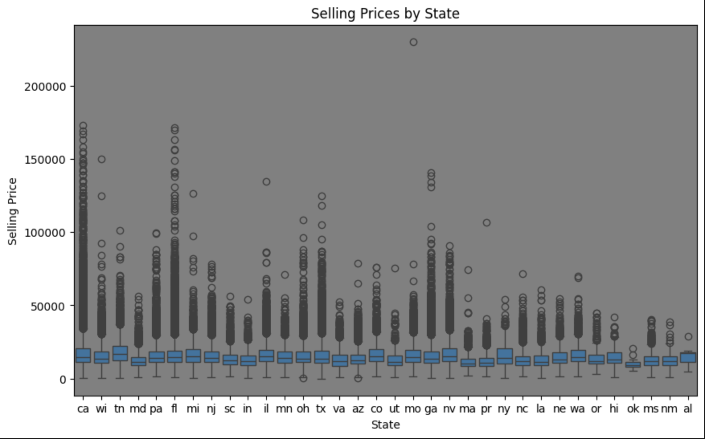
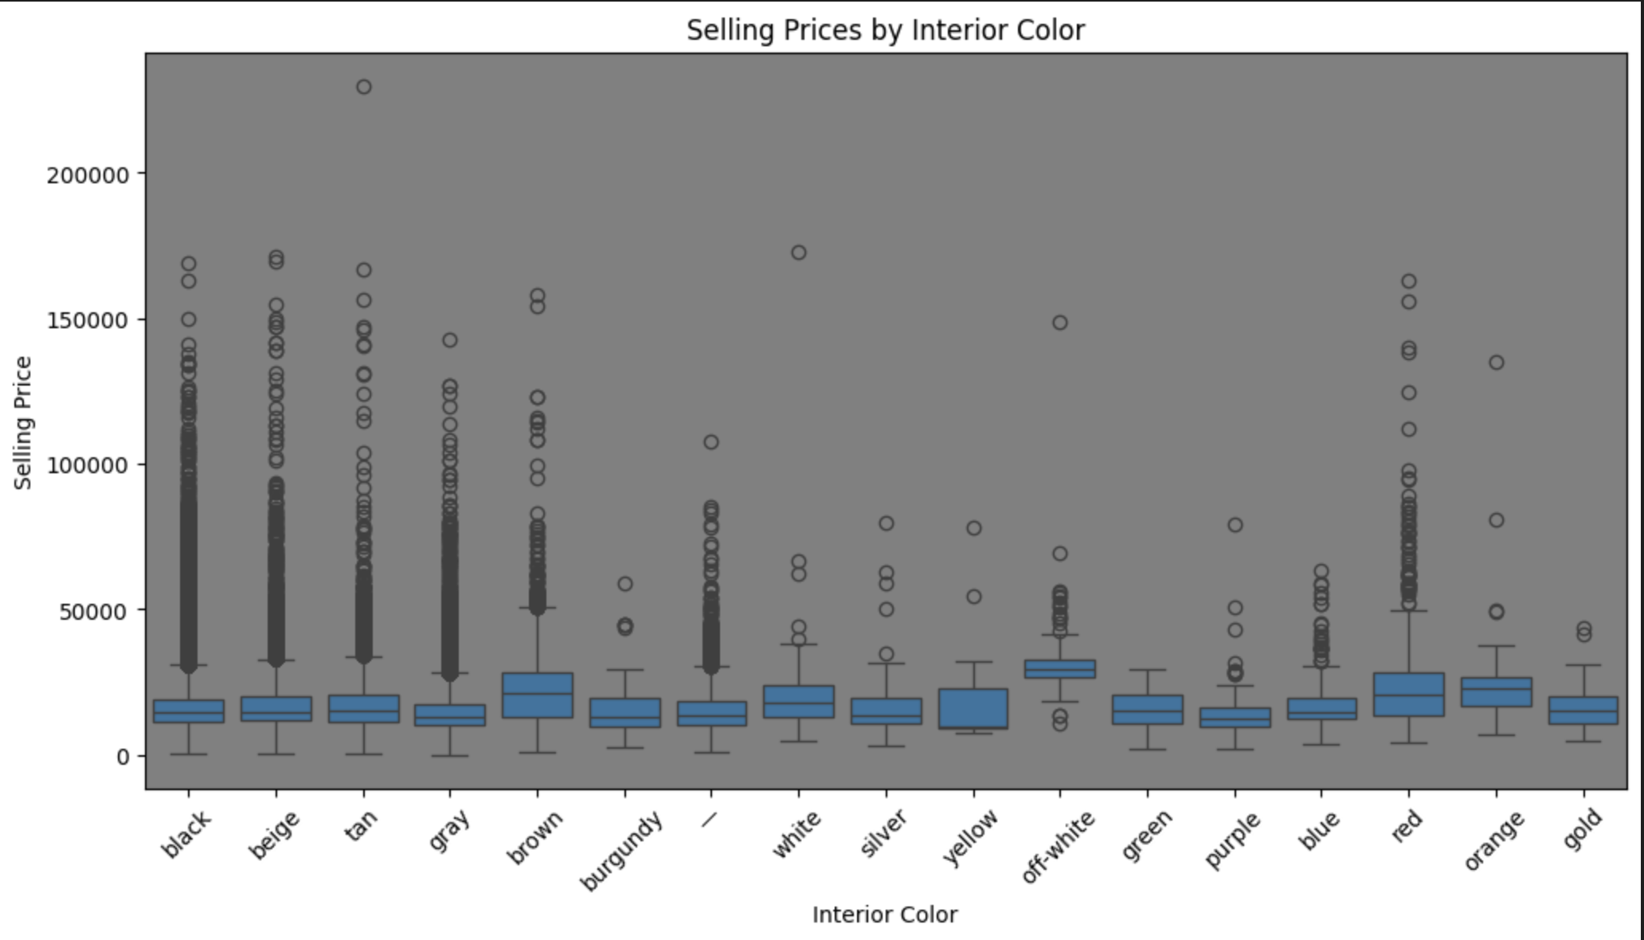
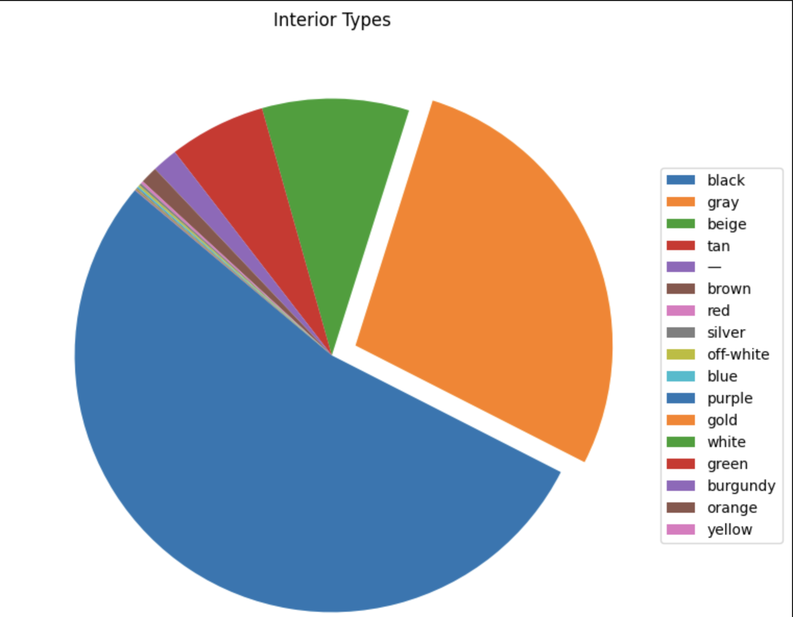
Data Insights

Slide 13
Choosing the right Machine Learning Model
03

Slide 14
Exploring Machine Learning Models
The selection of XGBoost was based on its ability to manage intricate and nonlinear data patterns. Decision trees are used in its ensemble learning to capture complex feature interactions without overfitting.
The advantages of XGBoost over alternatives such as linear regression, random forests, SVMs, and neural networks are its scalability and greater predictive accuracy.
Its performance in machine learning contests is proof of its efficacy. XGBoost is the best option because it meets the technical requirements and goals of our project.

Slide 15
Model Building and Analysis
04

Slide 16
Model Building
The selection of XGBoost was based on its ability to manage intricate and nonlinear data patterns. Decision trees are used in its ensemble learning to capture complex feature interactions without overfitting.
The advantages of XGBoost over alternatives such as linear regression, random forests, SVMs, and neural networks are its scalability and greater predictive accuracy.
Its performance in machine learning contests is proof of its efficacy. XGBoost is the best option because it meets the technical requirements and goals of our project.

Slide 17
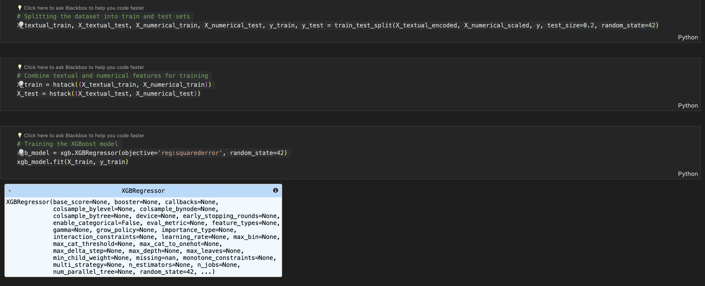
Model Building

Slide 18
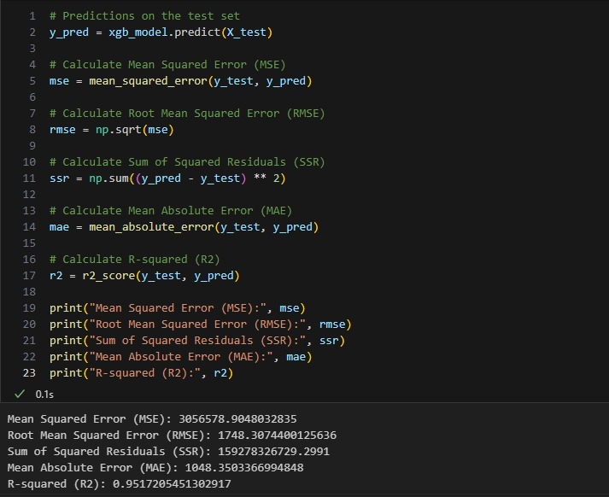
Model Evaluation

Slide 19
Model Evaluation
Mean Squared Error (MSE): MSE of 3056578.90 indicates an average squared difference of 3,056,578 between predicted and actual car prices, penalizing larger errors.
Root Mean Squared Error (RMSE): RMSE of 1748.31, the square root of MSE, measures average prediction error in original price units. A lower RMSE suggests model predictions have an average error of about 1,748.
Sum of Squared Residuals (SSR): SSR of 159278326729.30 represents the sum of squared differences between predicted and actual car prices, indicating the total residual error of the model.
Mean Absolute Error (MAE): MAE of 1048.35 measures the average absolute difference between predicted and actual car prices, capturing the average magnitude of errors regardless of their direction.
R-squared (R2): R2 of 0.9517 suggests the model explains about 95.17% of car price variance. Higher R2 values indicate better model fit to the data.

Slide 20
Model Evaluation
Our model's evaluation measures show strong performance, with low MAE and RMSE values indicating little errors. Furthermore, the strong R2 value indicates that a substantial amount of the volatility in automobile pricing is captured by our model. Even with these encouraging outcomes, it's crucial to place our findings in the context of the project's particular requirements and assess our model's performance against other methods or industry standards. Furthermore, maintaining our model's efficacy and dependability in practical applications would require constant observation and evaluation of its generalization abilities.

Slide 21
Visualizations and Predictions
05

Slide 22

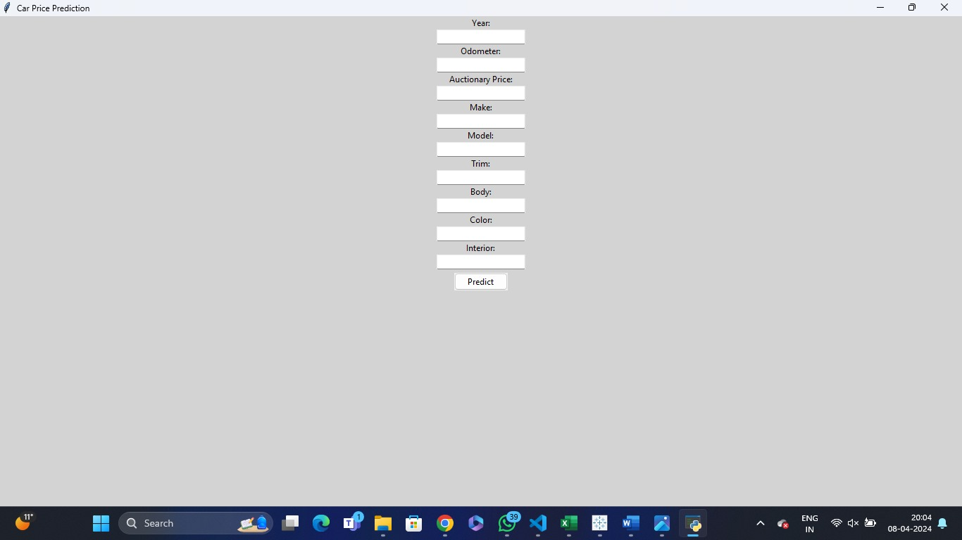
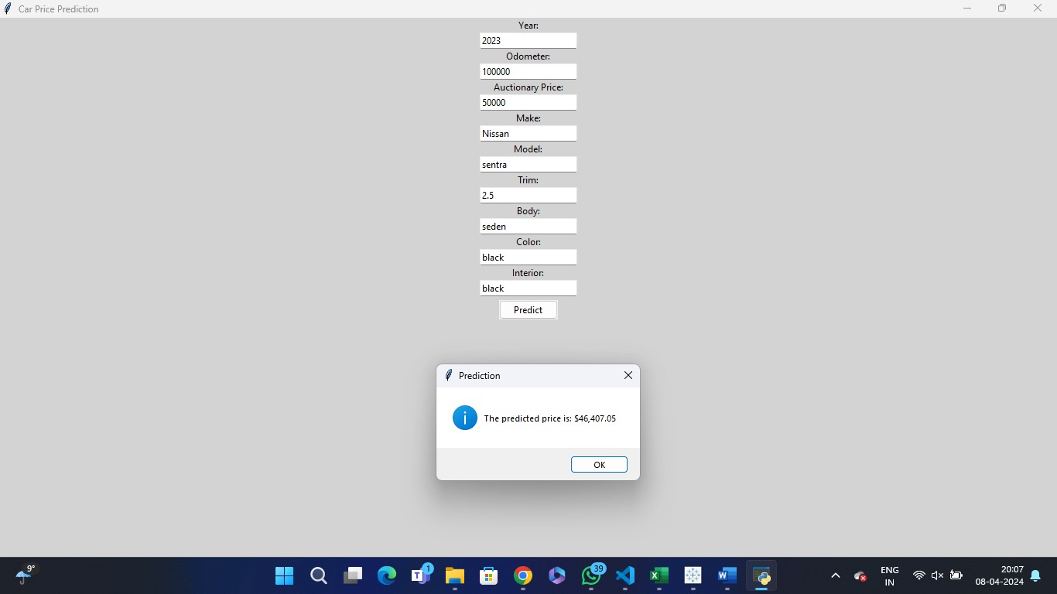
Visualizations

Slide 23
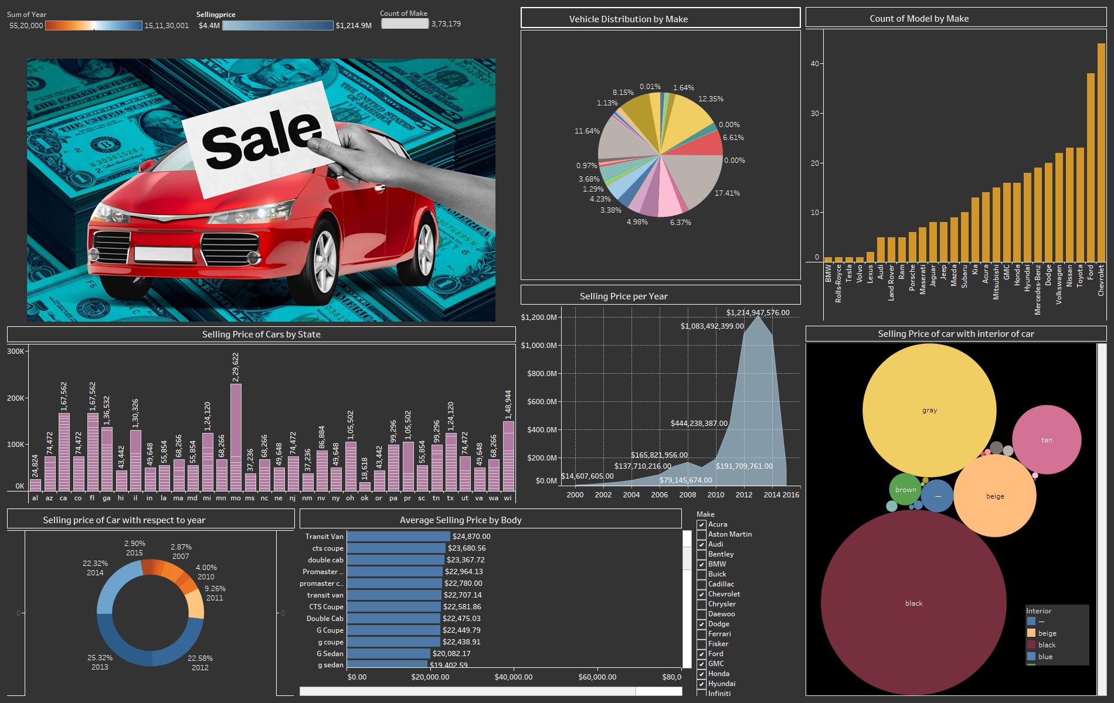
Visualizations

Slide 24
Conclusion
06

Slide 25
Conclusion
In conclusion, our XGBoost vehicle price prediction system improves market efficiency and decision-making by providing sellers, buyers, and industry experts with priceless insights. Notwithstanding obstacles, continuous improvements offer even more precision and usefulness, promoting openness and client contentment in the automotive sector.

Slide 26
Group members: Prabhsimran Singh(c0905791) Vidhamjot Kaur(c0909093) Anmol Singh Paman(c0908043) Gurpreet Kaur(c0908454) Sarabjot Singh(c0909102)
Thank you

